Slide 1








IMDB MOVIE SALES ANALYSIS
Presented by : Abhishek Goud

Slide 2




PROJECT OBJECTIVE
The goal of this project is to analyze movie industry performance through an interactive Power BI dashboard. The dashboard visualizes key metrics such as revenue trends, genre popularity, ratings, and performance by director and actors. It empowers stakeholders to understand which factors drive success in the movie business—across genres, years, and regions—and supports strategic decisions in film production, marketing, and distribution.

Slide 3




BACKGROUND
TOOLS & TECHNOLOGIES:
KEY VISUALS:
Power BI Desktop – Visualizations & DAX
Power Query – Data transformation
Excel/CSV – Raw dataset source
DAX – Measures & calculated columns
Total Revenue by Year (Stacked Bar Chart)
Revenue by Genre (Stacked Column / Donut Chart)
Trend of movies by rank ,metascore (Area Chart)
KPI for Revenue earned by movies (KPI)
Count of movies by Genre(Pie Chart)

Slide 4



PROJECT GOALS
Track Revenue Growth: Visualize year-over-year revenue to identify trends and market performance.
Analyze Genre Impact: Compare revenues and title counts by genre to see what audiences prefer.
Evaluate Quality Metrics: Monitor average IMDB ratings and Metascore to assess viewer and critic reception.
Segment Contributors: Count and filter by actors, directors, and genres for performance insights.
Enable Dynamic Filtering: Use slicers for Year, Genre, and Director to perform on-the-fly filtering.
.

Slide 5
KEY FEATURES
Summary Cards: Count of titles, genres, actors, directors, and average runtime.
Time Analysis: Revenue trends over the years (2006–2016).
KPI Tracking: Target vs. actual revenue, including % overachievement.
Genre Distribution: Pie chart of title count by genre and bar chart of revenue by genre.
Performance Trends: Line chart combining revenue, Metascore, and rank.
Filters: Year, Genre, and Director slicers for deep dive analysis.
.

Slide 6
SAMPLE INSIGHTS
Action and Animation genres generated the highest revenue.
Revenue saw a consistent upward trend from 2006 to 2016.
In 2016, the industry earned $11.2K million, exceeding the $5K target by 124%.
Metascore and Rank positively correlated with rising revenue from 2010 onward.
Top-performing genres make up ~50% of total titles but generate ~75% of total revenue.

Slide 7
LINKS
DashBoard Link : https://app.powerbi.com/groups/me/reports/4a736738-04a8-470c-a847-090522ae55a8/ed2bd49e0f03c26cae8b?experience=power-bi
Github Project Link : https://github.com/Abhishek1232333
Linkedin Project Link : www.linkedin.com/in/abhishek-goud-860720251

Slide 8


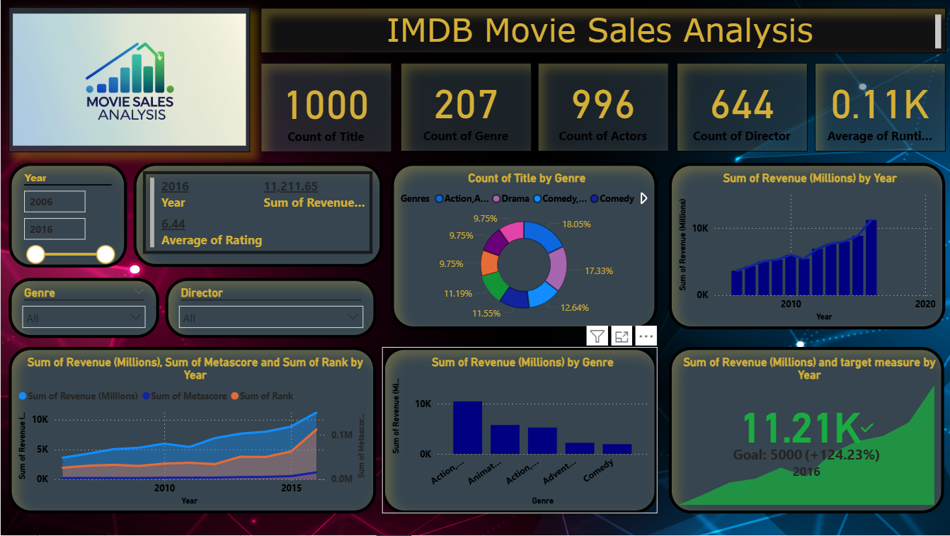

DASHBOARD

Slide 9


THANK YOU

